Slide 1


Milot M.
05 Dec 2023

Slide 2

Outline
Executive Summary
Introduction
Methodology
Results
Conclusion
Appendix

Slide 3
Executive Summary
The highest success ratio has KSC LC-39A site
The most successful version that has the highest success ratio is FT Booster
Payload Mass has the highest success ratio
The most cost reducing is the Reusable Falcon 9 rocket

Slide 4
Introduction
The aim of the project is to build an appropriate model for forecasting the likelihood of successful landing. It is as result of leveraging predictive data based on machine learning field
Cost effectivity is very important for aerospace industry players and for the environment as well. In this project, SpaceX’s Falcon 9 resulted as most effective one
The methodology used in this project includes data collection, data wrangling, model selection and model evaluation
Cost competitiveness in aerospace industry is very significant due to direct environment impact

Slide 5

Section 1

Slide 6
Methodology
Executive Summary
Data collection methodology:
Data was collected using SpaceX API and Web Scraping from Wikipedia.
Perform data wrangling
Missing values were replaced with Mean Value.
Perform exploratory data analysis (EDA) using visualization and SQL
Perform interactive visual analytics using Folium and Plotly Dash
Perform predictive analysis using classification models
Different classification models were chosen and the best parameters were found for tunning. Also, the last evaluate accuracy and precision is presented.

Slide 7
Data Collection
Data was collected using:
SpaceX API and
Web Scraping from Wikipedia.

Slide 8
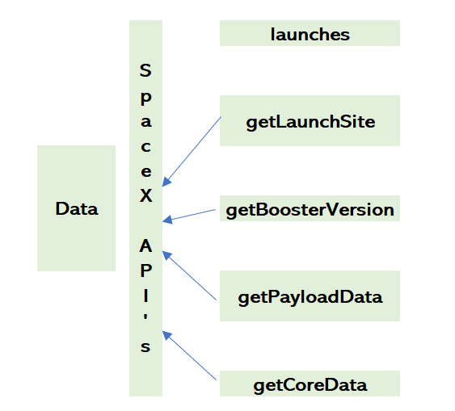
Data Collection – SpaceX API
Couple of API’s were used for data collection, as presented on the right side.
testrepo/jupyter-labs-spacex-data-collection-api.ipynb at main · mmilotm/testrepo (github.com)
Place your flowchart of SpaceX API calls here

Slide 9
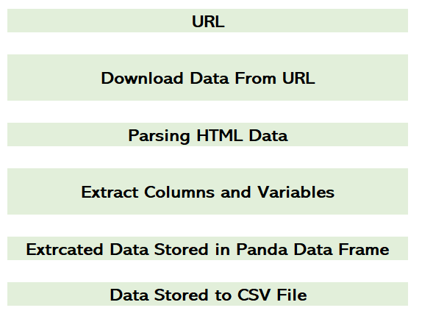
Data Collection - Scraping
BeautifulSoup used for web scraping from Wikipedia.
URL:
https://en.wikipedia.org/wiki/List_of_Falcon_9_and_Falcon_Heavy_launches
testrepo/jupyter-labs-webscraping.ipynb at main · mmilotm/testrepo (github.com)
Place your flowchart of web scraping here

Slide 10
Data Wrangling
Cleaned the data
Structured the data in a suitable form for analysis
testrepo/labs-jupyter-spacex-Data wrangling.ipynb at main · mmilotm/testrepo (github.com)

Slide 11
EDA with Data Visualization
Following Charts Plotted:
Flight Number vs Payload Mass
Flight Number vs Launch Site
Payload vs Launch Site
Flight Number vs Orbit type
Payload vs Orbit type
Success rate of each orbit type
testrepo/jupyter-labs-eda-dataviz.ipynb.jupyterlite.ipynb at main · mmilotm/testrepo (github.com)

Slide 12
EDA with SQL
Summary of the SQL queries performed as below:
Unique launch site names in the space mission
5 records where launch sites begin with the string 'CCA’
The total payload mass carried by boosters launched by NASA (CRS)
Average payload mass carried by booster version F9 v1.1
List the date when the first successful landing outcome in ground pad was achieved
List the names of the boosters which have success in drone ship and have payload mass greater than 4000 but less than 6000
List the total number of successful and failure mission outcomes
The names of the booster versions which have carried the maximum payload mass using sub query
testrepo/jupyter-labs-eda-sql-coursera_sqllite.ipynb at main · mmilotm/testrepo (github.com)

Slide 13
Build an Interactive Map with Folium
Summary of the map objects used as below:
Marker – to specify locations on the map
Circle – presenting the circle around the point on the map
Line – to connect multiple points
testrepo/jupyter-labs-eda-dataviz.ipynb.jupyterlite.ipynb at main · mmilotm/testrepo (github.com)

Slide 14
Build a Dashboard with Plotly Dash
Summarize what plots/graphs and interactions you have added to a dashboard
Explain why you added those plots and interactions
testrepo/jupyter-labs-eda-dataviz.ipynb.jupyterlite.ipynb at main · mmilotm/testrepo (github.com)

Slide 15
Predictive Analysis (Classification)
Created an output variable
Standardized the data, cleaned, trained and tested
Classification Models used: SVM, Classification Trees and Logistic Regression
Grid search used to find the best tuned parameters for prediction
Accuracy and Confusion Matrix is checked for model validation
testrepo/SpaceX_Machine_Learning_Prediction_Part_5.jupyterlite.ipynb at main · mmilotm/testrepo (github.com)

Slide 16
Results
Exploratory data analysis results
The success rate kept increasing till 2020 since 2013
Interactive analytics demo in screenshots
KSC LC-39A site as the highest success ratio
Predictive analysis results
Best Model Confusion Matrix

Slide 17

Section 2

Slide 18
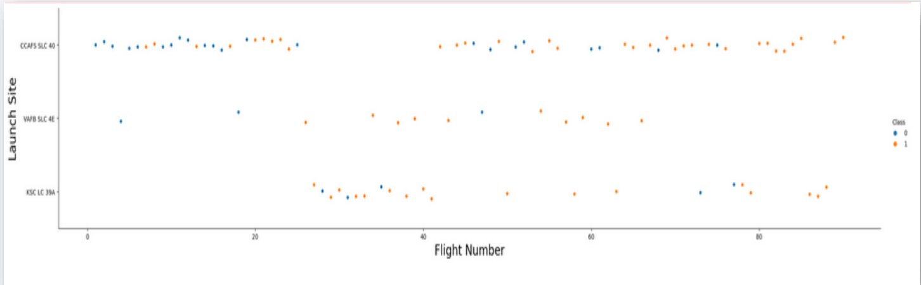
Flight Number vs. Launch Site
Show a scatter plot of Flight Number vs. Launch Site
Success ration is increasing along with flight number

Slide 19
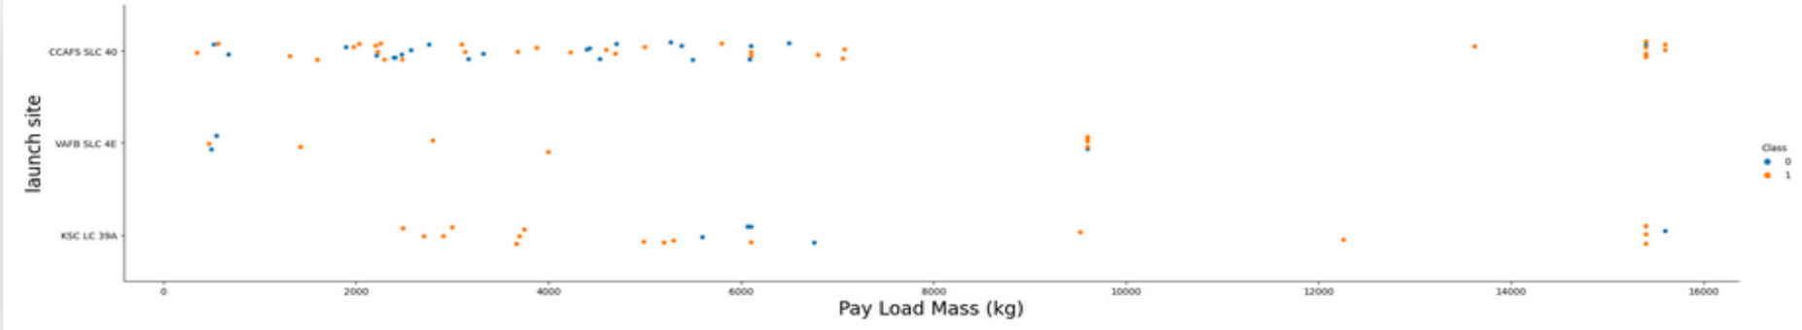
Payload vs. Launch Site
Show a scatter plot of Payload vs. Launch Site
VAFB-SLC launch site there are no rockets launched for heavy payload mass(greater than 10000).

Slide 20
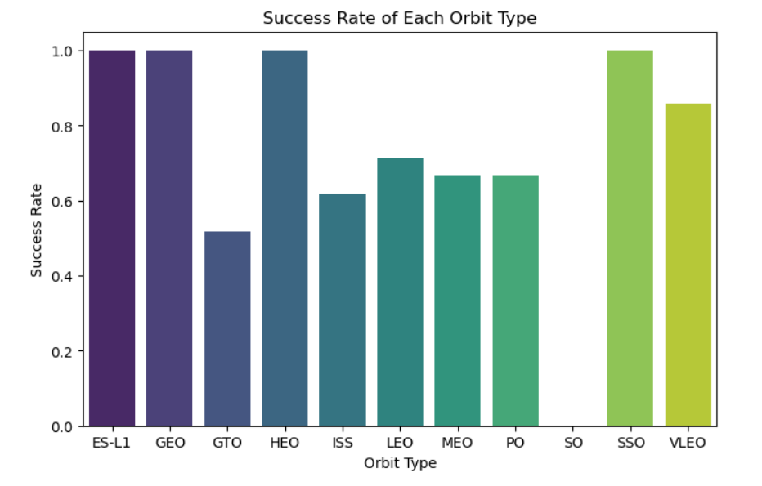
Success Rate vs. Orbit Type
Show a bar chart for the success rate of each orbit type
ES-L1, GEO, HEO, SSO having success ratio as compared to others

Slide 21
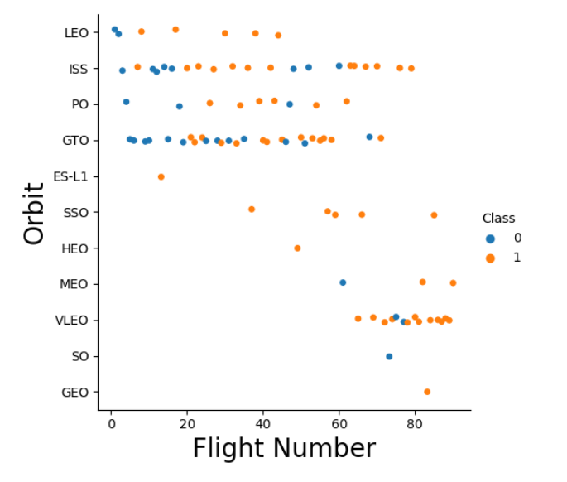
Flight Number vs. Orbit Type
Show a scatter point of Flight number vs. Orbit type
LEO orbit the Success appears related to the number of flights; on the other hand, there seems to be no relationship between flight number when in GTO orbit

Slide 22
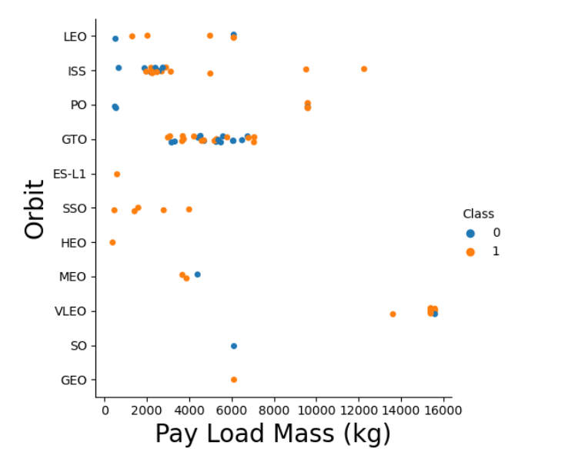
Payload vs. Orbit Type
Show a scatter point of payload vs. orbit type
GTO we cannot distinguish as we have both values
With heavy payloads the successful landing or positive landing rate are more for Polar, LEO and ISS plot with explanations

Slide 23
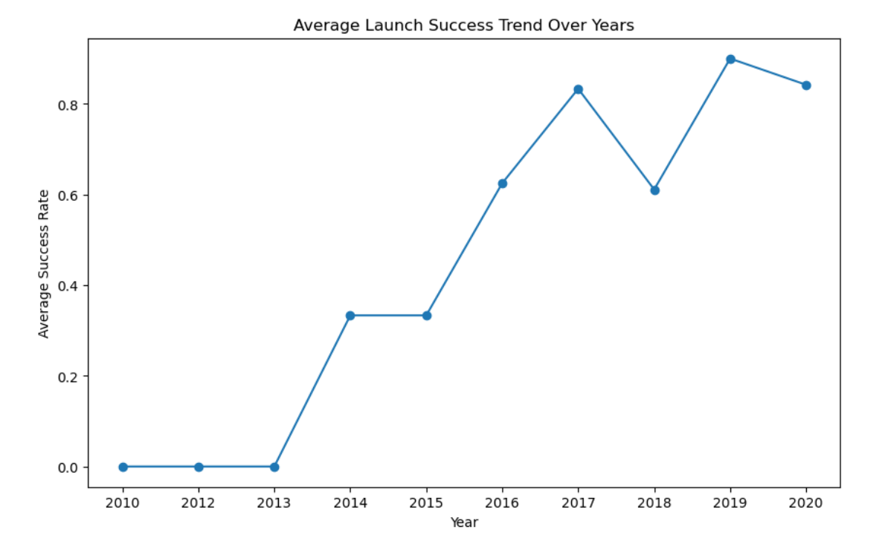
Launch Success Yearly Trend
Show a line chart of yearly average success rate
The success ratio kept increasing till 2020, since 2013.

Slide 24
All Launch Site Names
Names of the unique launch sites are listed below:
CCAFS LC-40
VAFB SLC-4E
KSC LC-39A
CCAFS SLC-40
The query result is presented as below:

Slide 25
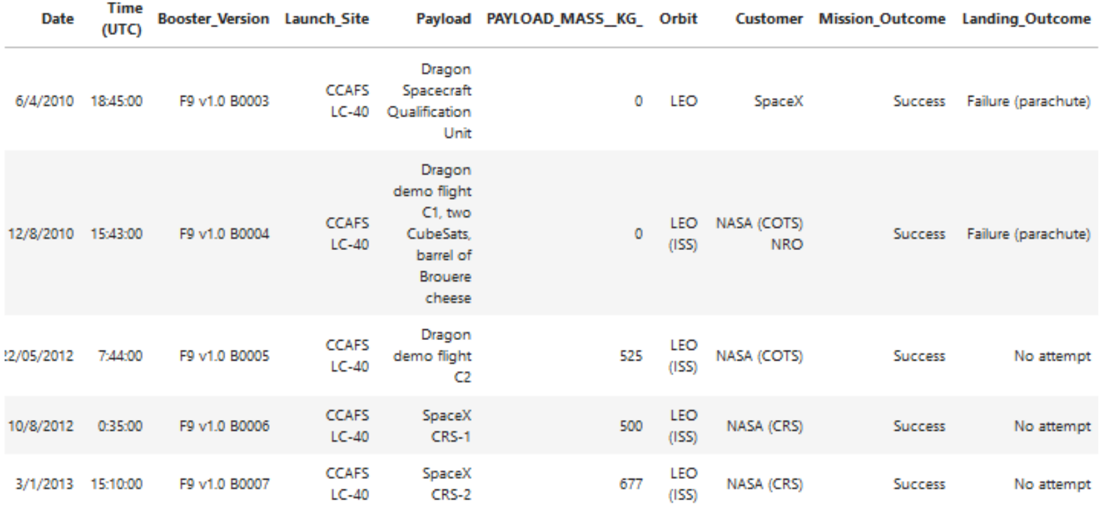
Launch Site Names Begin with 'CCA'
5 records where launch sites begin with `CCA`

Slide 26
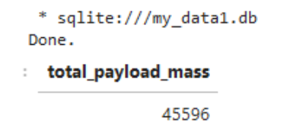
Total Payload Mass
Total payload carried by boosters from NASA
The query result is presented below

Slide 27
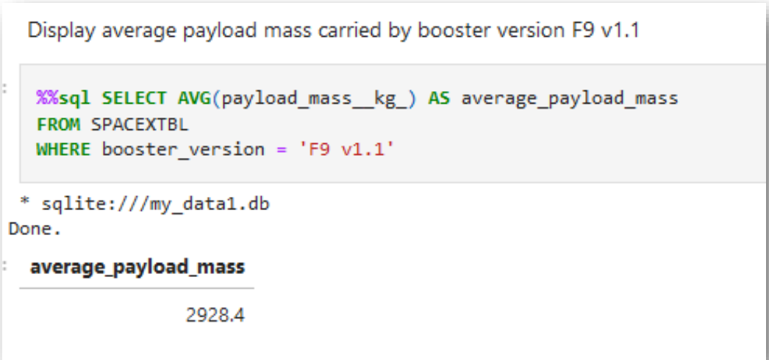
Average Payload Mass by F9 v1.1
Calculate the average payload mass carried by booster version F9 v1.1
The query result is presented below

Slide 28
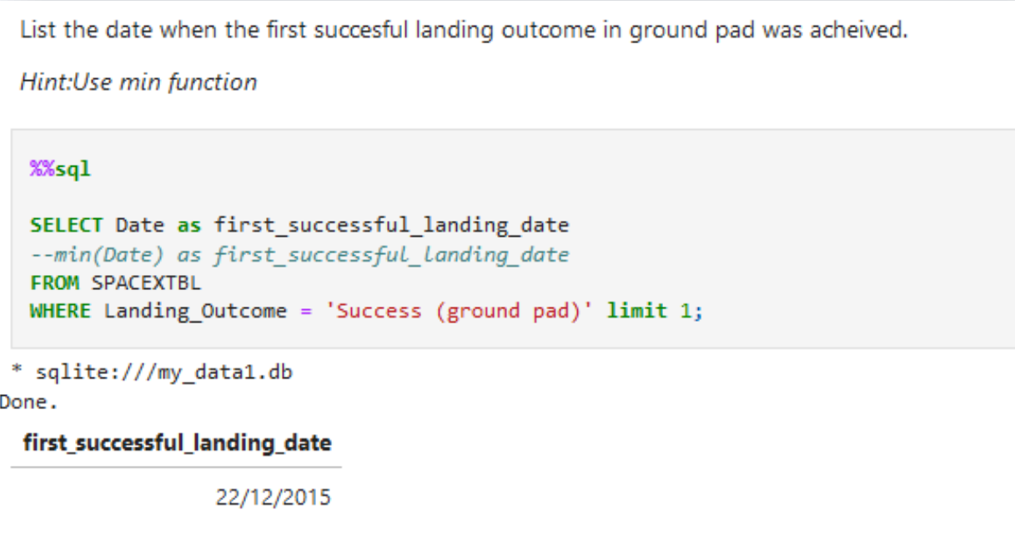
First Successful Ground Landing Date
Find the dates of the first successful landing outcome on ground pad
The query result is presented below

Slide 29
Successful Drone Ship Landing with Payload between 4000 and 6000
List the names of boosters which have successfully landed on drone ship and had payload mass greater than 4000 but less than 6000
F9 FT B1022
F9 FT B1026
F9 FT B1021.2
F9 FT B1031.2

Slide 30
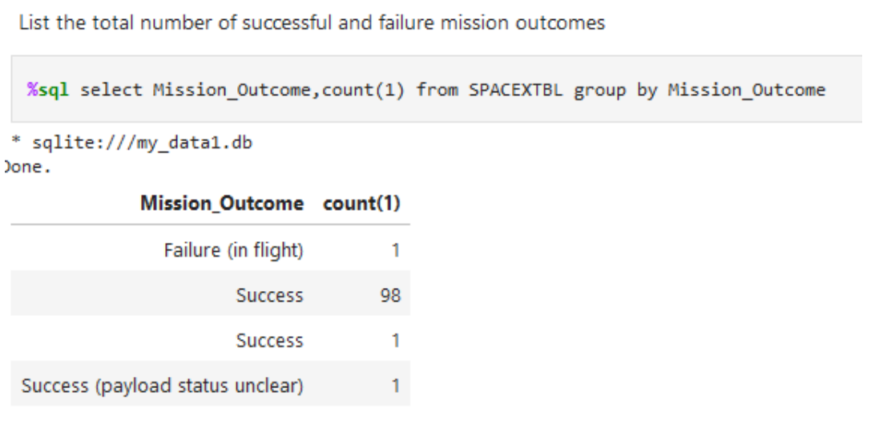
Total Number of Successful and Failure Mission Outcomes
Calculate the total number of successful and failure mission outcomes
The query result is presented below

Slide 31
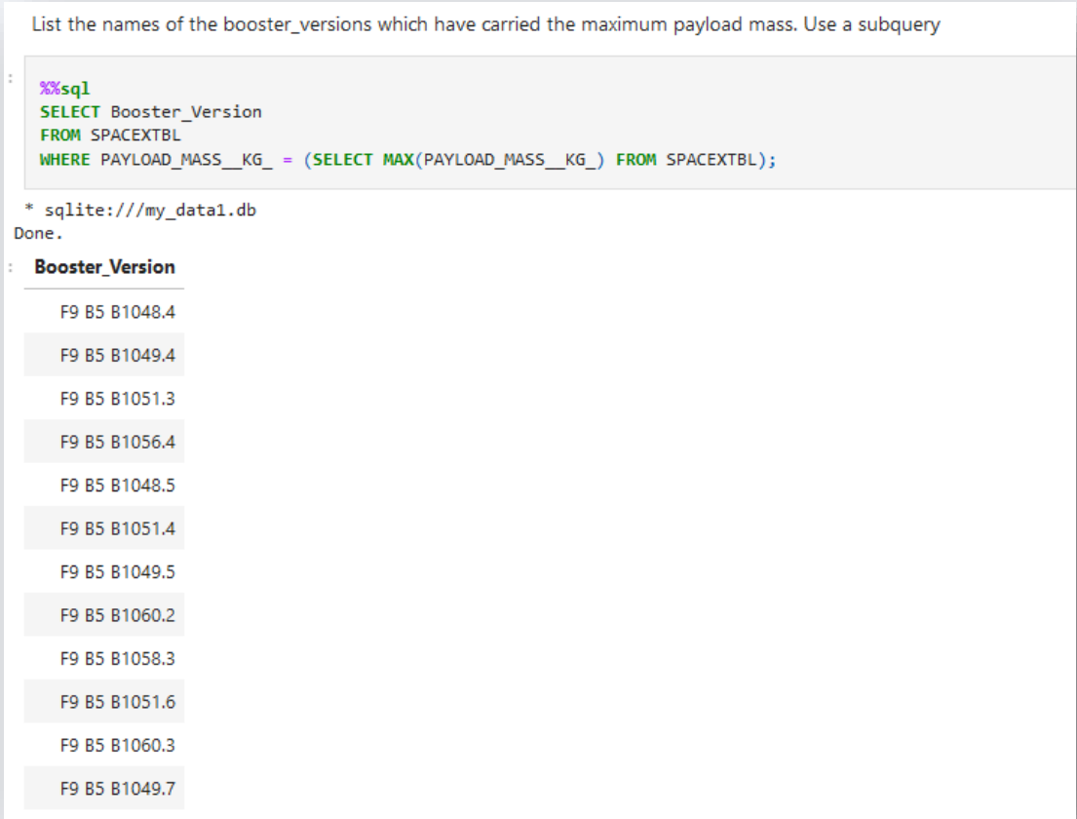
Boosters Carried Maximum Payload
List the names of the booster which have carried the maximum payload mass
The query result is presented below

Slide 32
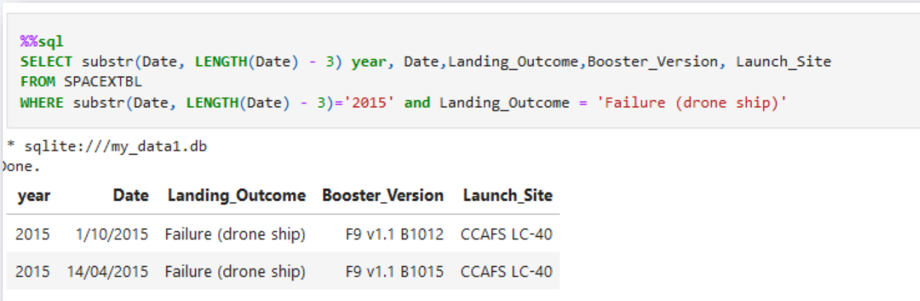
2015 Launch Records
List the failed landing_outcomes in drone ship, their booster versions, and launch site names for in year 2015
The query result is presented below

Slide 33
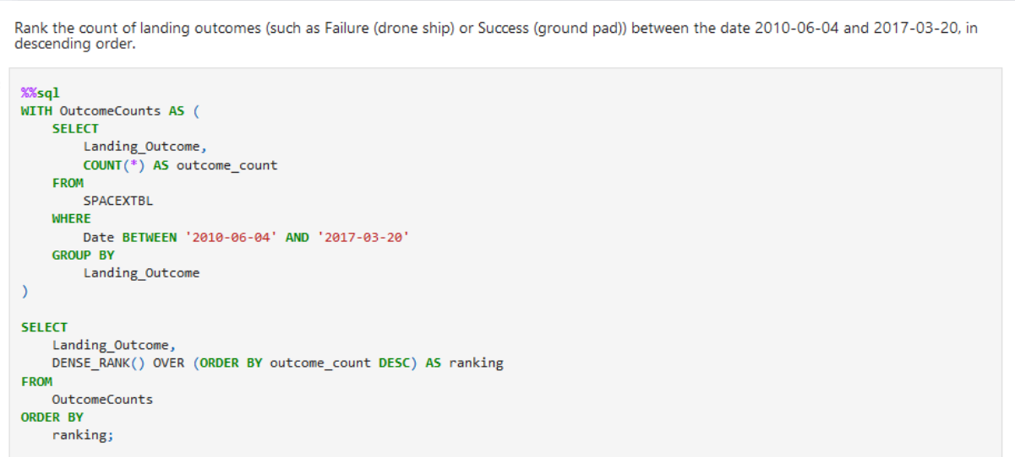
Rank Landing Outcomes Between 2010-06-04 and 2017-03-20
Rank the count of landing outcomes (such as Failure (drone ship) or Success (ground pad)) between the date 2010-06-04 and 2017-03-20, in descending order
The query result is presented below

Slide 34

Section 3

Slide 35
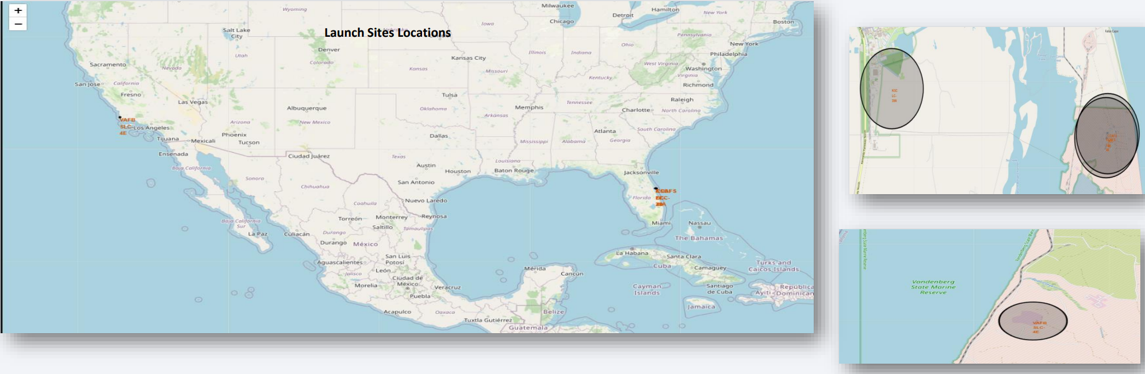
ALL SITES LOCATIONS

Slide 36
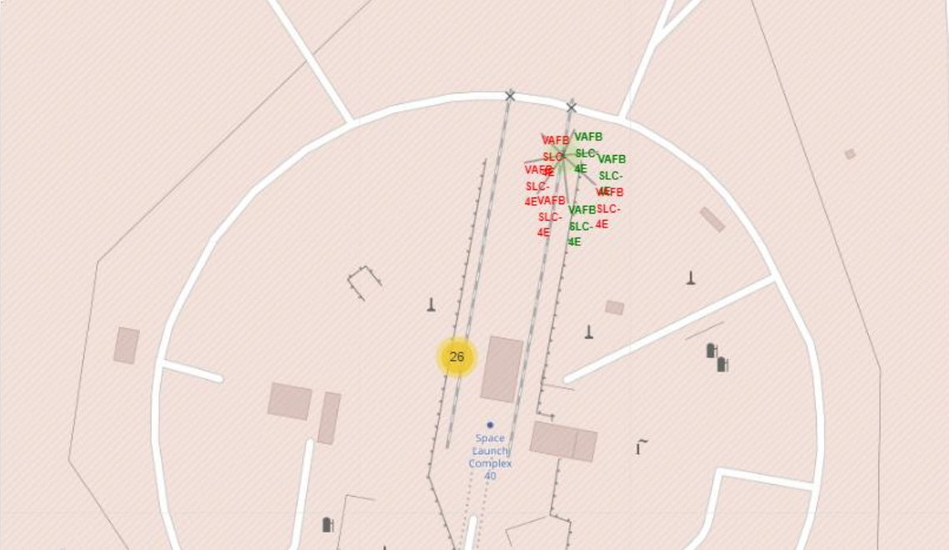
SITE SLC 40

Slide 37
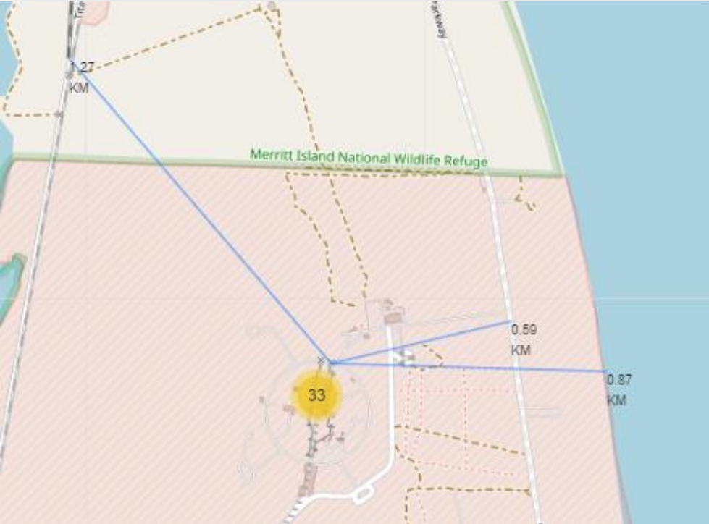
SITE SLC 40

Slide 38

Section 4

Slide 39
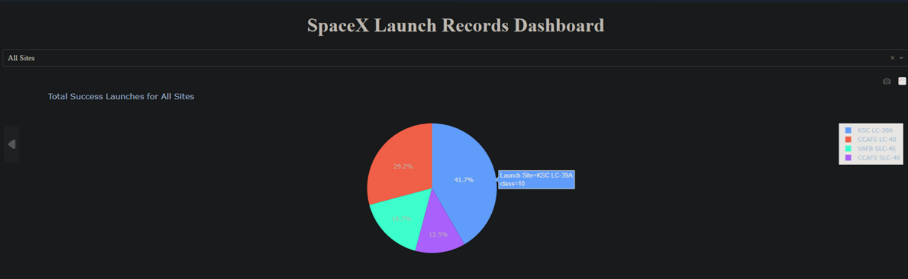
ALL SITES

Slide 40
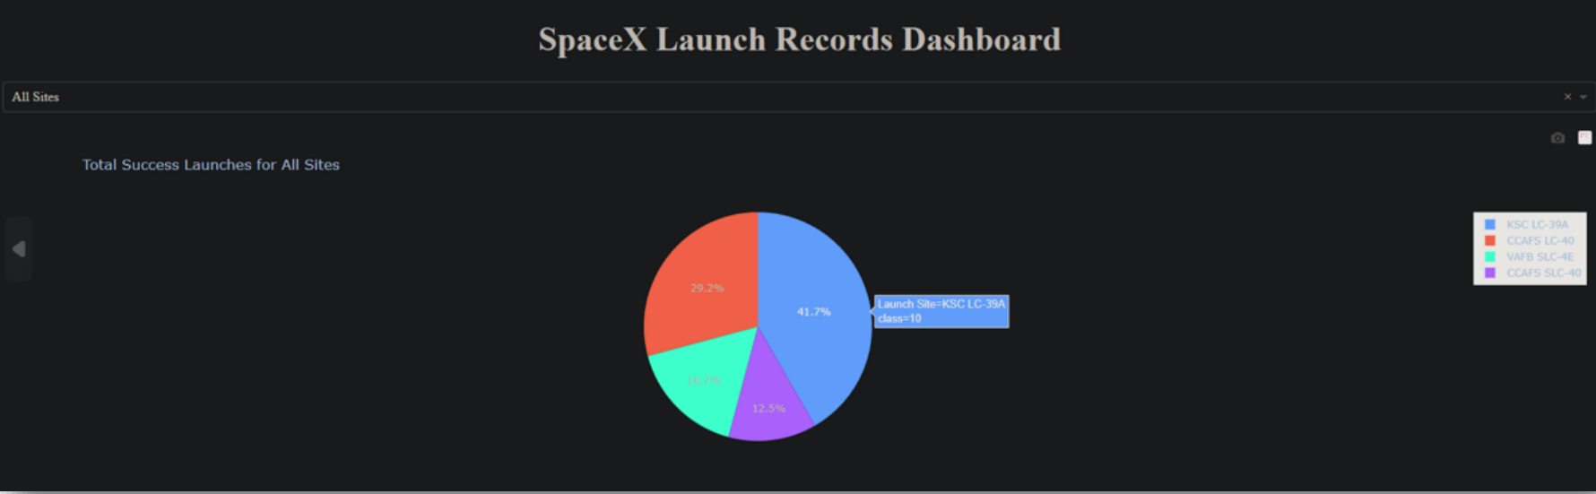
KSC LC-39A – 41.7% Success Ratio

Slide 41
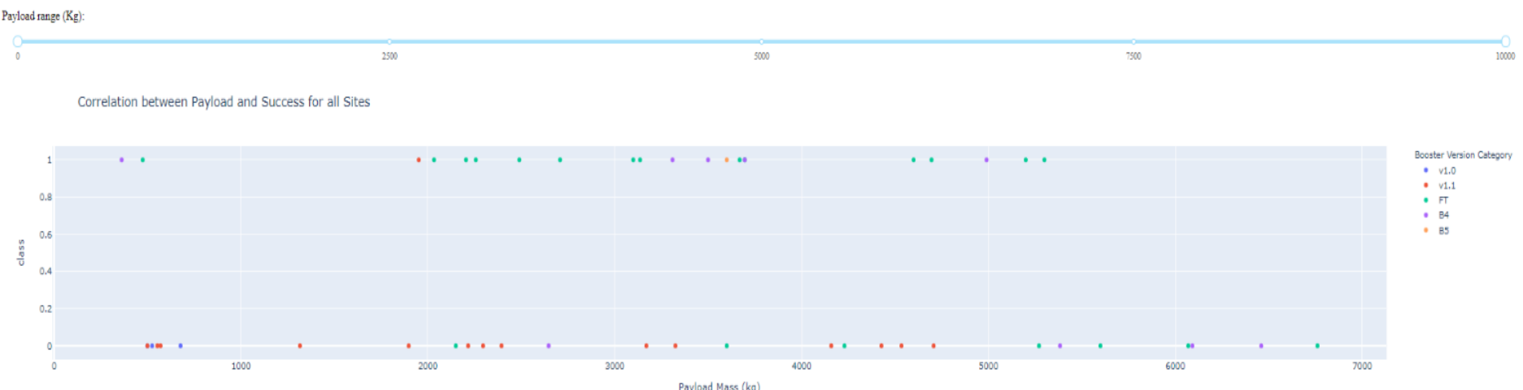
PAYLOAD vs. LAUNCH OUTCOME

Slide 42

Section 5

Slide 43
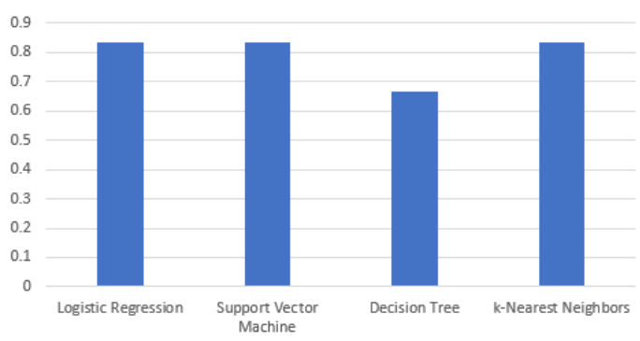
Classification Accuracy
Highest accuracy of classification models 0.8333333333333334
Logistic Regression
Support Vector Machine
KNN

Slide 44
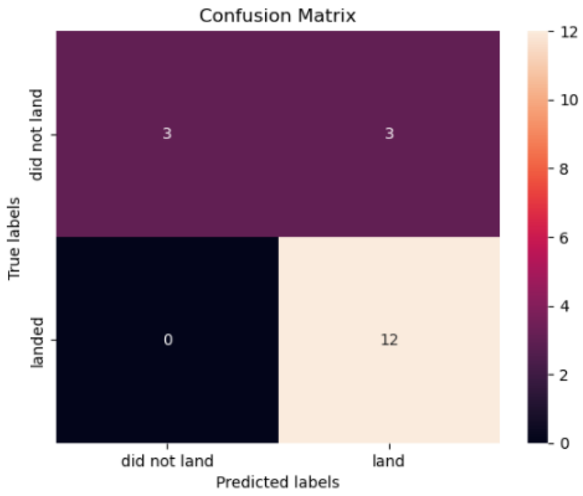
Confusion Matrix
Confusion matrix with the best performing model has the highest sum of true positives and true negatives

Slide 45
Conclusions
The highest success ratio has KSC LC-39A site
The most successful version that has the highest success ratio is FT Booster
Payload Mass has the highest success ratio
The most cost reducing is the Reusable Falcon 9 rocket

Slide 46


